Slide 1
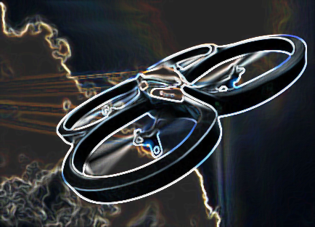
CSCI 5551 Fall 2015 Term Project UAV Applications Image Based Tracking of Mobile Object
John Erickson
eric0870@umn.edu
Computer Science and Engineering Department
The University of Minnesota at Twin Cities

Slide 2
Agenda
Problem Description
Implementation
Conclusions
Acknowledgements

Slide 3
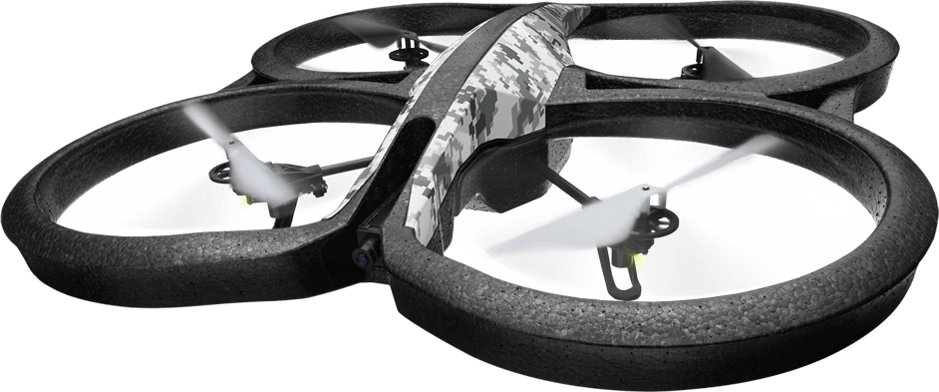
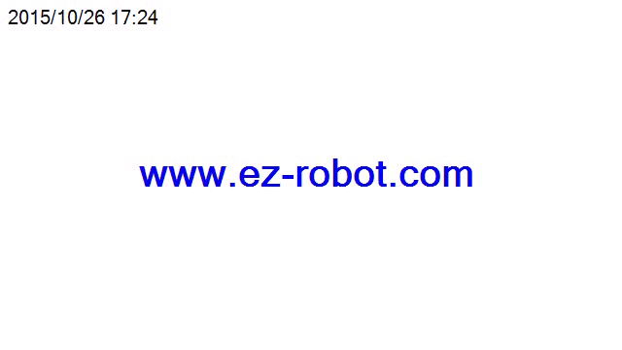
Problem Description
Create Follow Me application to allow a drone to autonomously follow an object through space
To meet project schedule, open source tools and COTS hardware leveraged
Parrot AR.Drone 2.0 quadcopter and SDK
ROS and Autonomy Lab
Proof of concept via EZ-Builder

Slide 4
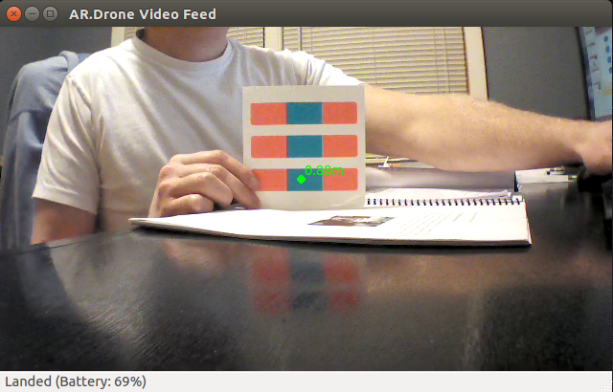
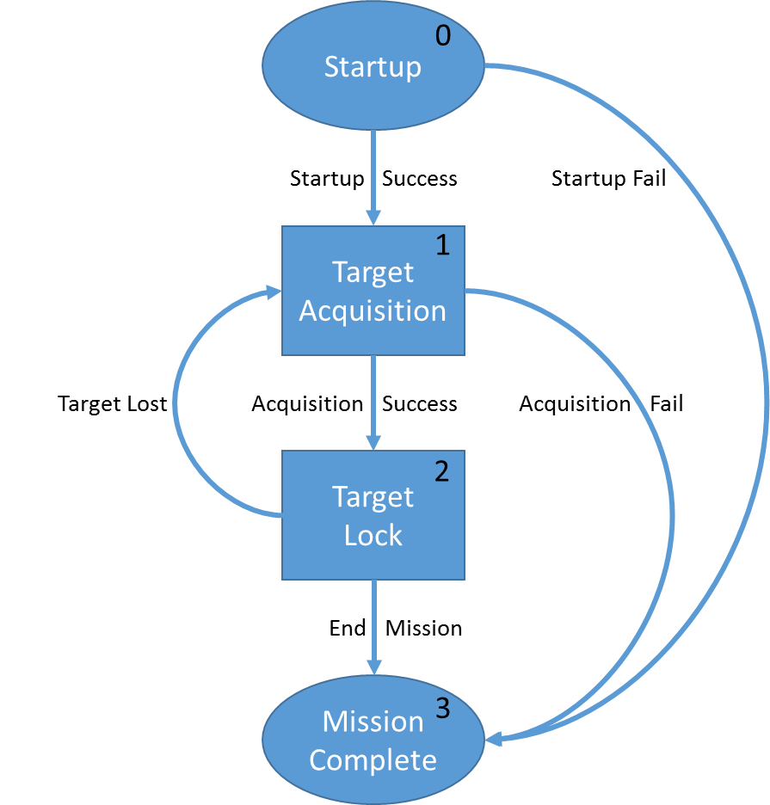
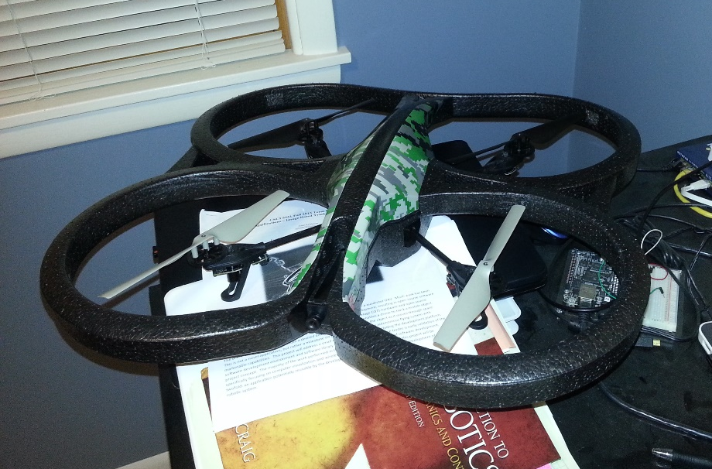
Implementation
Follow Me
AR. Drone Autonomy
AR.Drone SDK 2.0
ROS
Linux

Slide 5
Conclusions
Challenges
Integration of open source tools
Drone flight stability (particularly for indoor flight)
Assessment
Application well supported by community (framework and examples)
Opportunity to leverage open source software and affordable COTS hardware made for a great project application and learning experience
Future Work
Add capability to acquire and track object based on digital image
Port application to mobile host (requires UAV with onboard user processor)

Slide 6
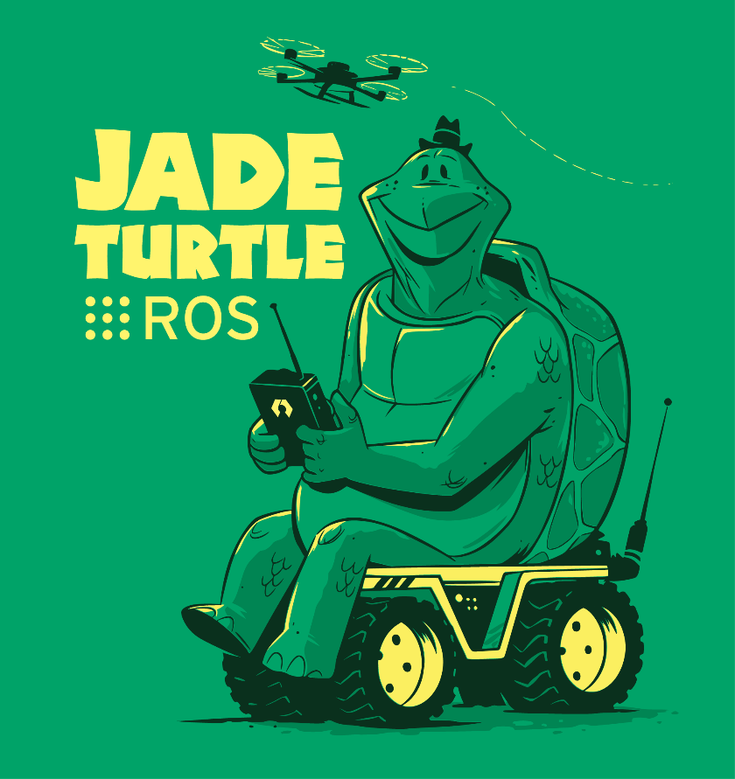
Acknowledgements
AR.Drone SDK, Parrot
ROS, Open Source Robotics Foundation
Autonomy Lab, Simon Frasier University
AR.Drone Tutorials, Mike Hammer
EZ-Robot, D.J. Sures

